Slide 1
Vector Calculus

Slide 2
Many algorithms in machine learning optimize an objective function with respect to a set of desired model parameters that control how well a model explains the data:
Finding good parameters can be phrased as an optimization problem.
Examples include: (i) linear regression, where we look at curve-fitting problems and optimize linear weight parameters to maximize the likelihood.
(ii) neural-network auto-encoders for dimensionality reduction and data compression, where the parameters are the weights and biases of each layer, and where we minimize a reconstruction error by repeated application of the chain rule; and
(iii) Gaussian mixture models for modeling data distributions, where we optimize the location and shape parameters of each mixture component to maximize the likelihood of the model.

Slide 3
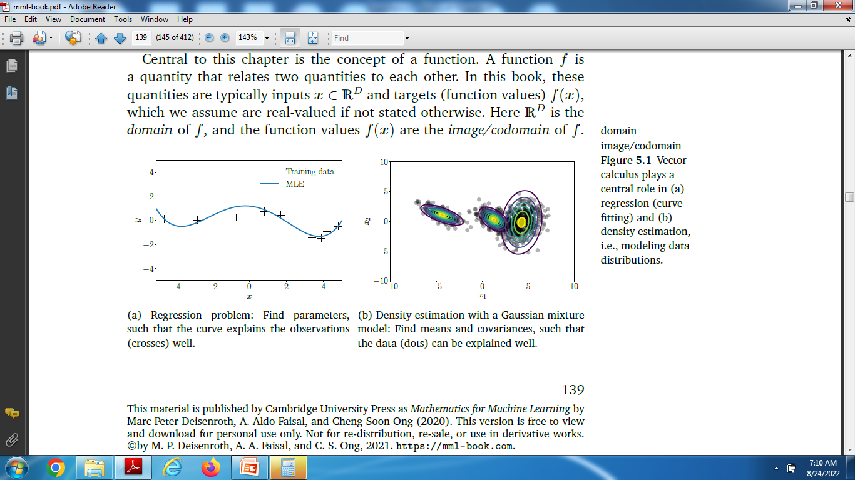
These problems, which we typically solve by using optimization algorithms that exploit gradient information

Slide 4
Central to this vector calculus is the concept of a function.
A function f is a quantity that relates two quantities to each other.
These quantities are typically inputs x ϵ R^{D} and targets (function values) f(x), which we assume are real-valued if not stated otherwise.
Here R^{D} is the domain of f, and the function values f(x) are the image/codomain of f.

Slide 5
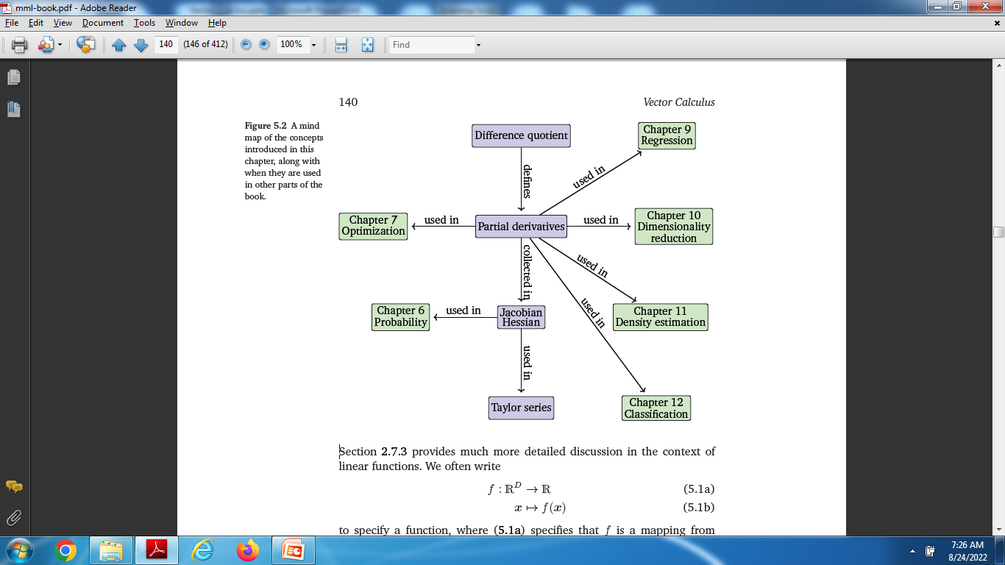
Use of Partial Differentiation

Slide 6
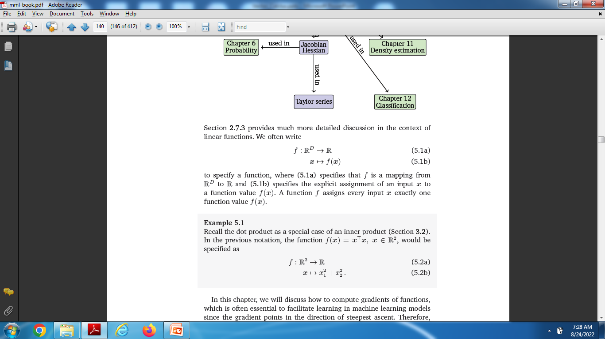

Slide 7
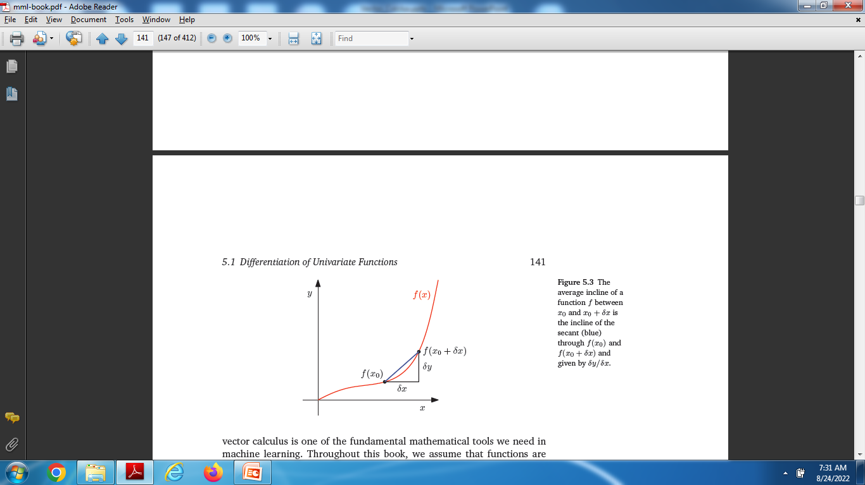
Computation of Gradient

Slide 8
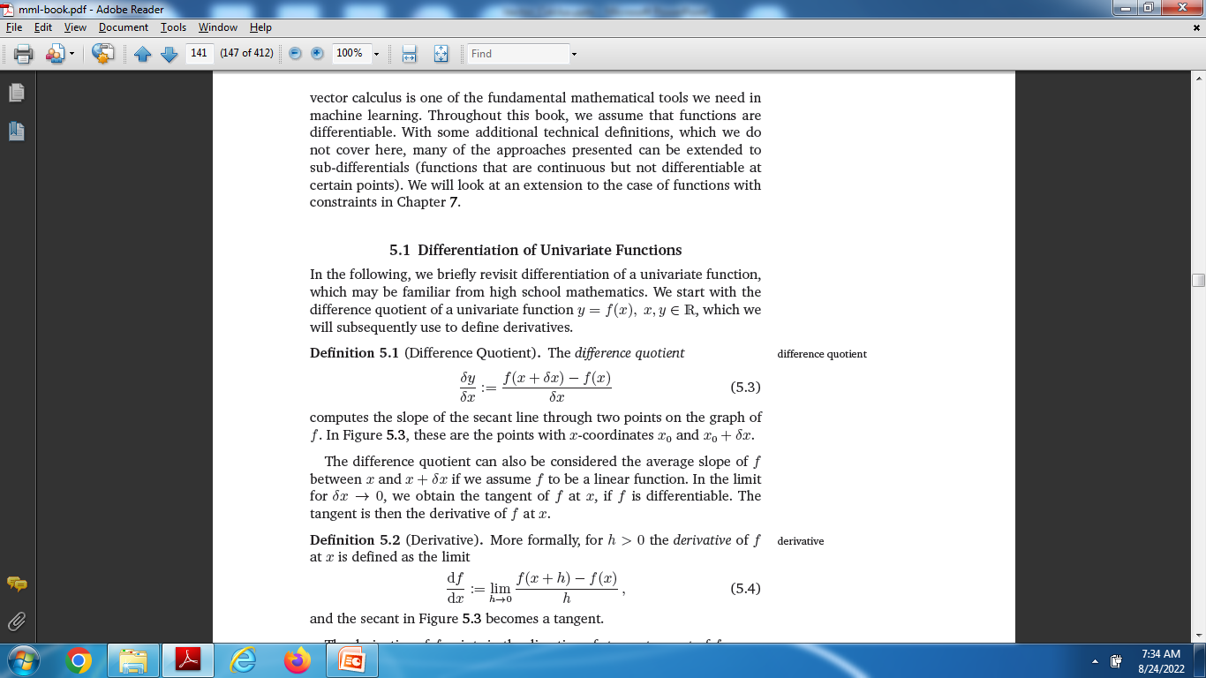
Differentiation of Univariate Functions

Slide 9
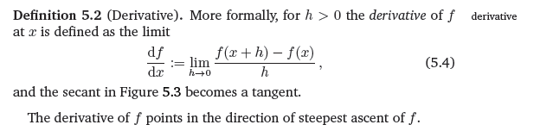
Derivative

Slide 10
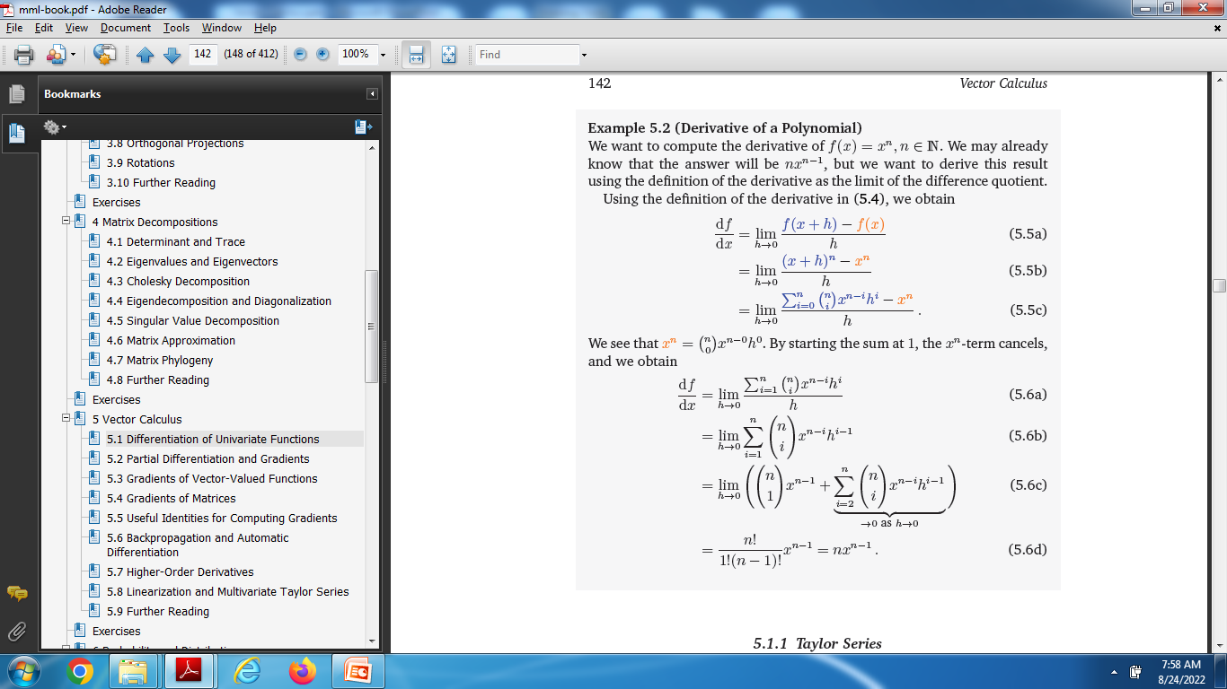
Deriavative Examples

Slide 11
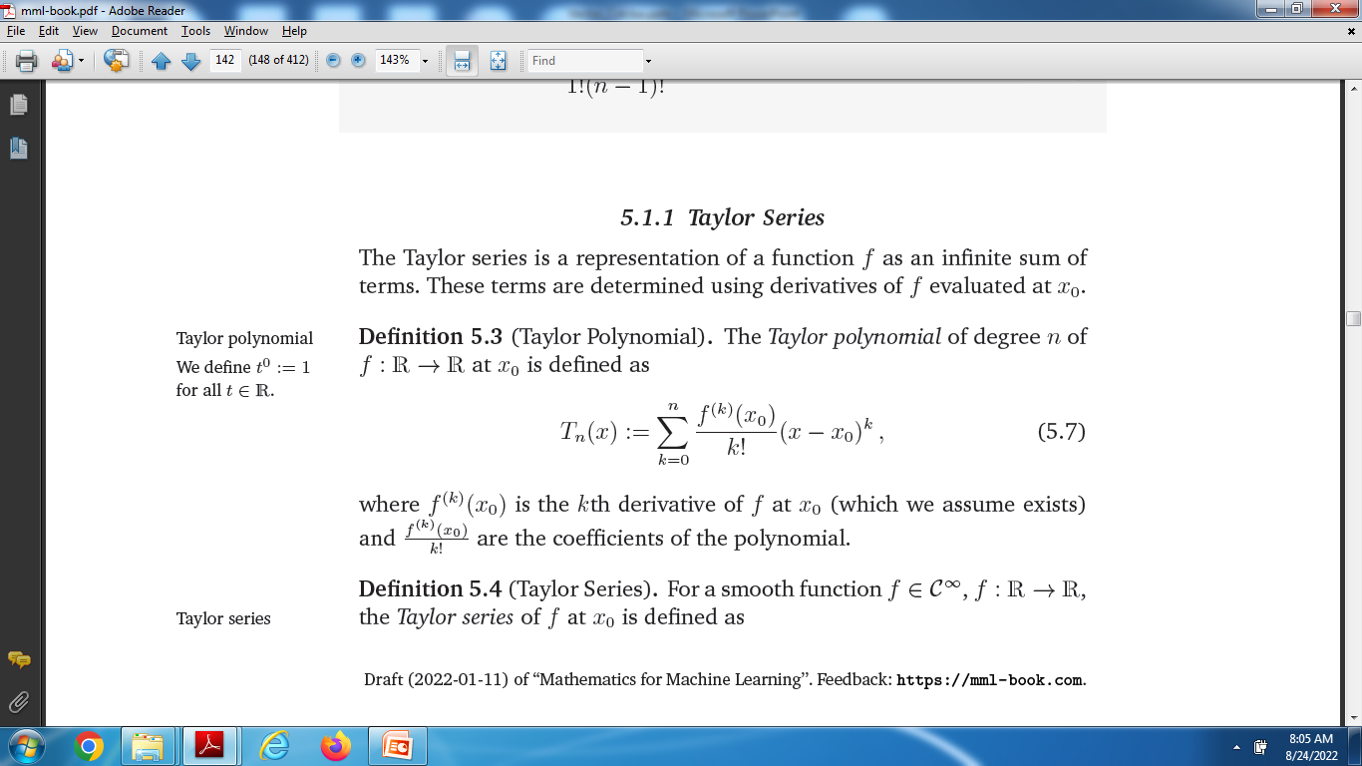
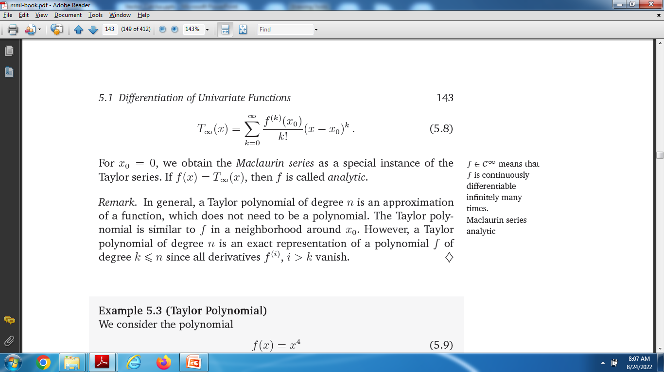
Taylor Series

Slide 12
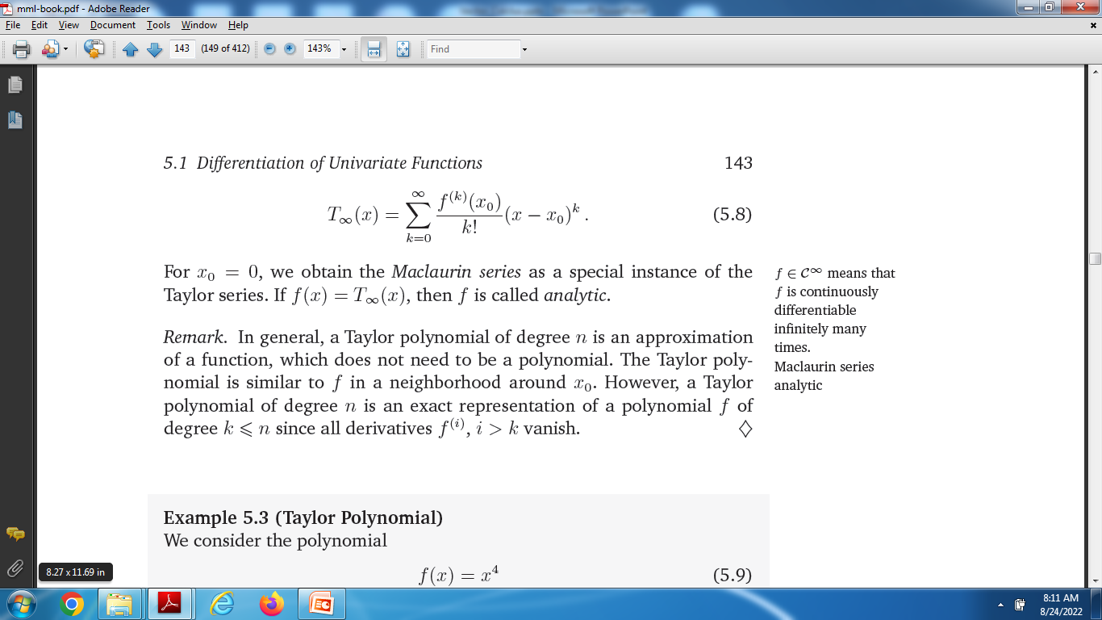
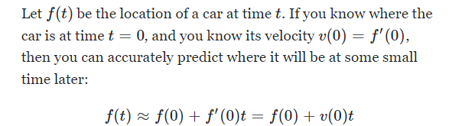
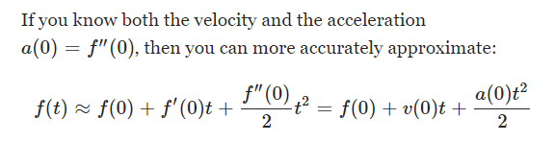
Taylor Series

Slide 13
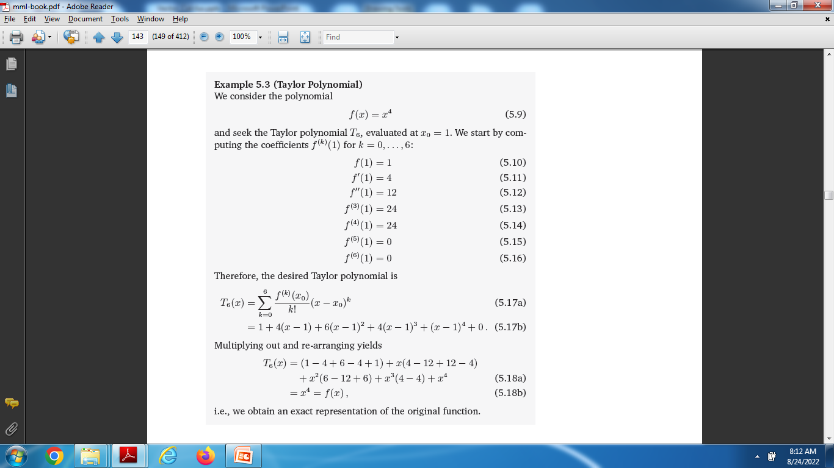

Slide 14
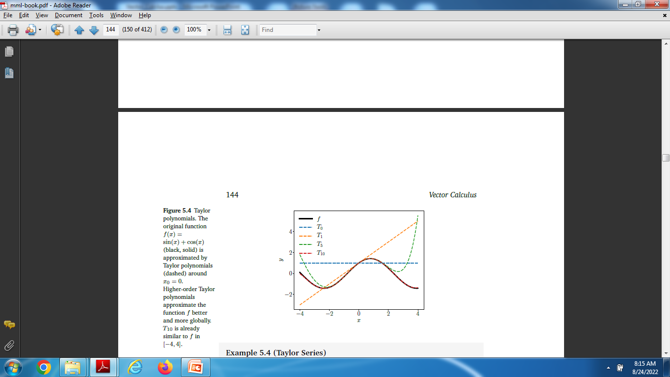
Taylor Polynomials

Slide 15
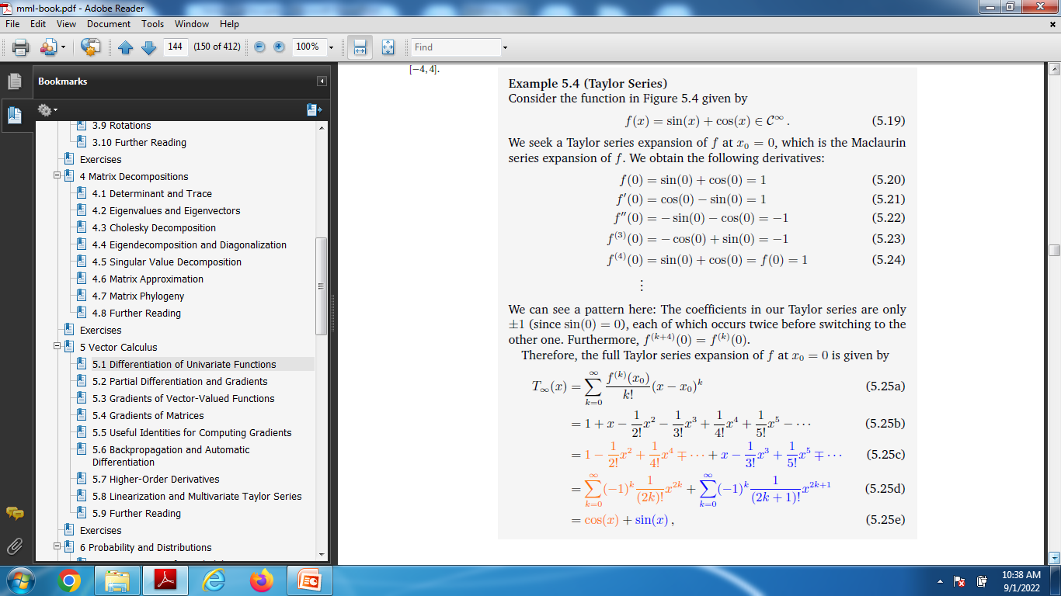
Power Series

Slide 16
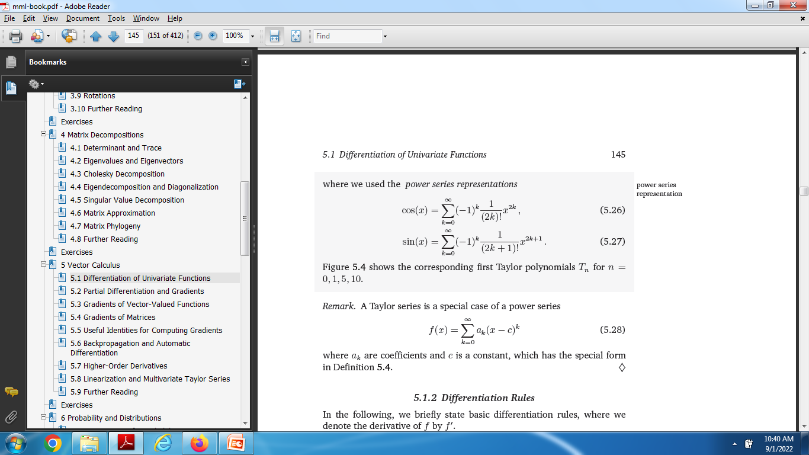

Slide 17
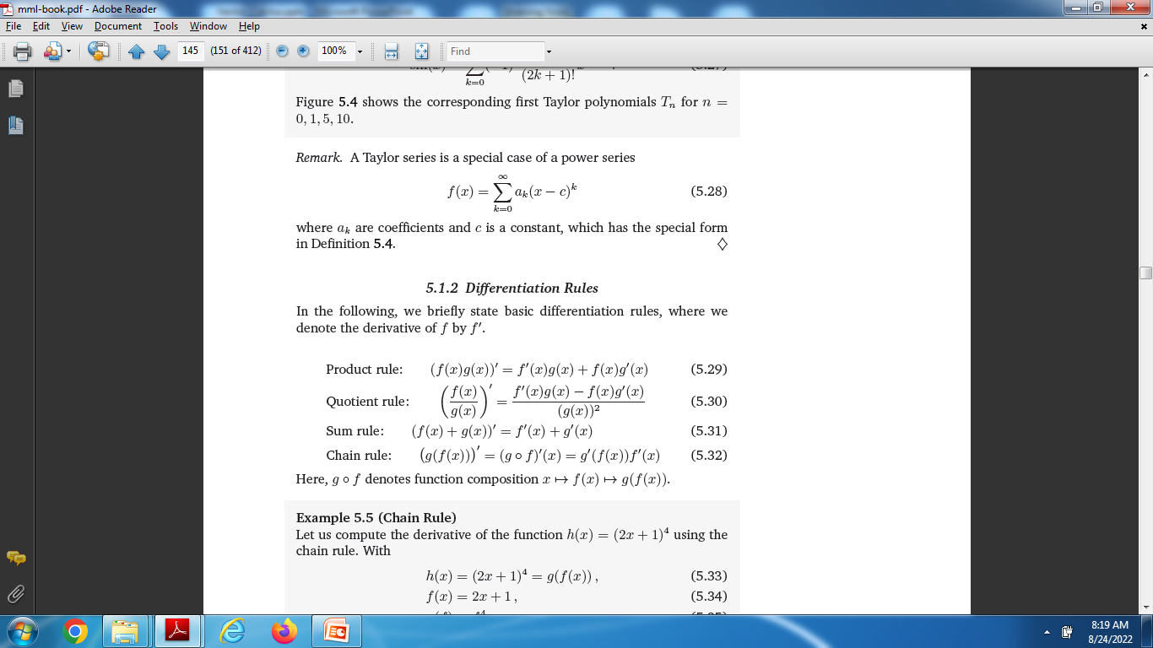
Differentiation Rules

Slide 18
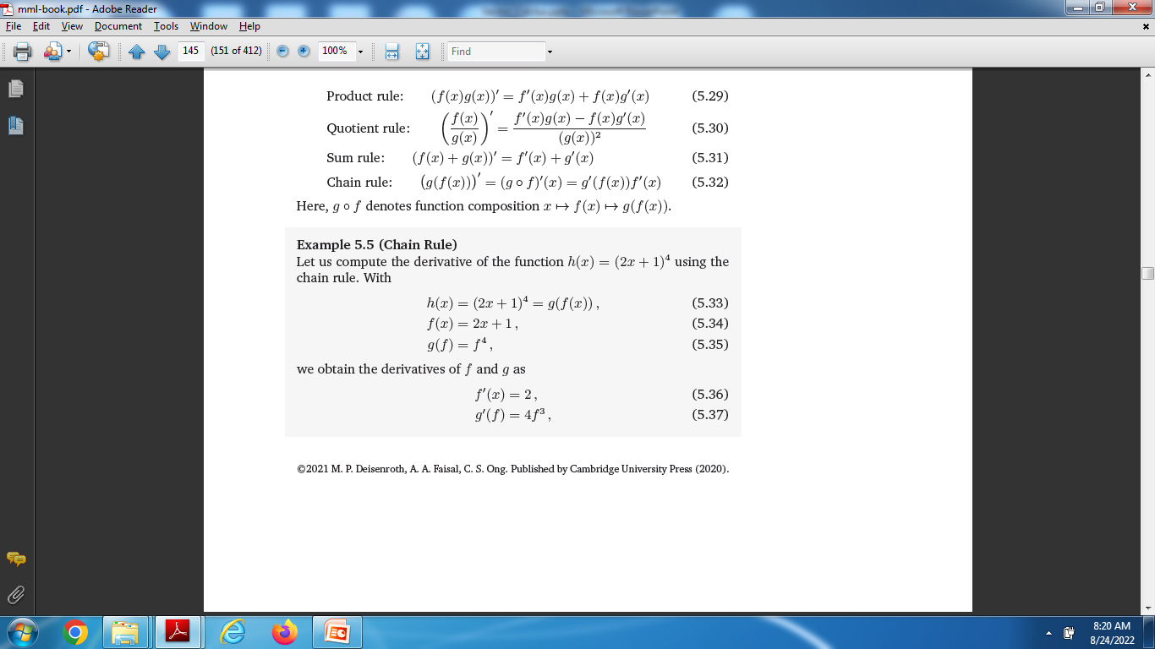
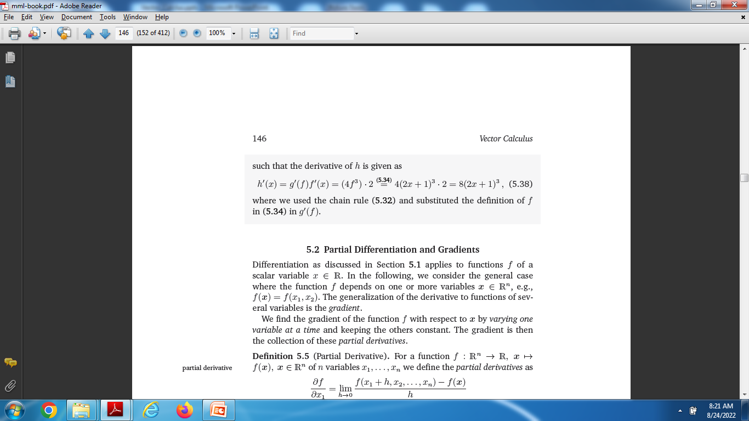

Slide 19
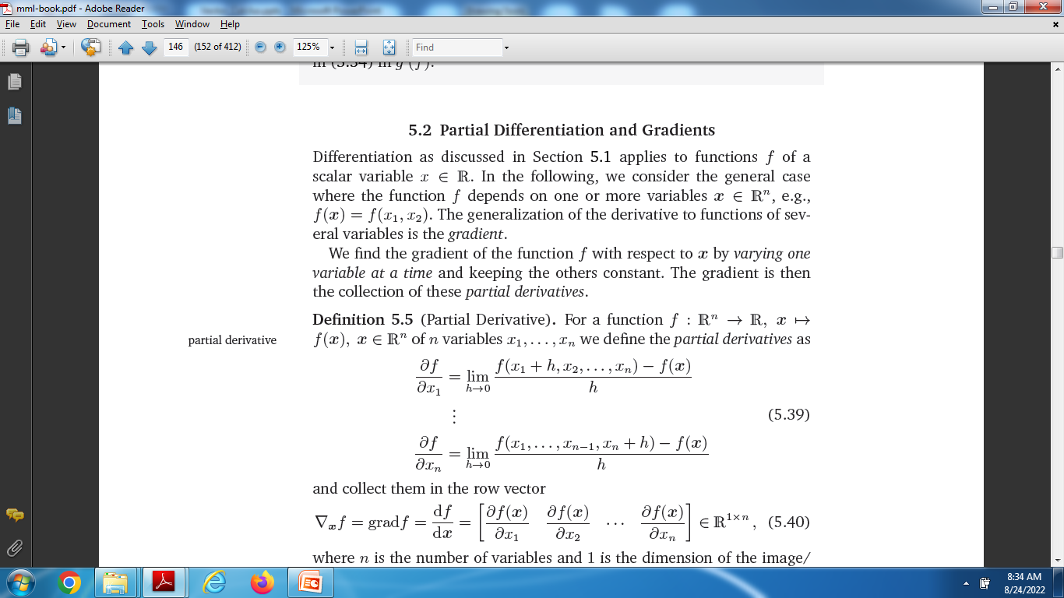
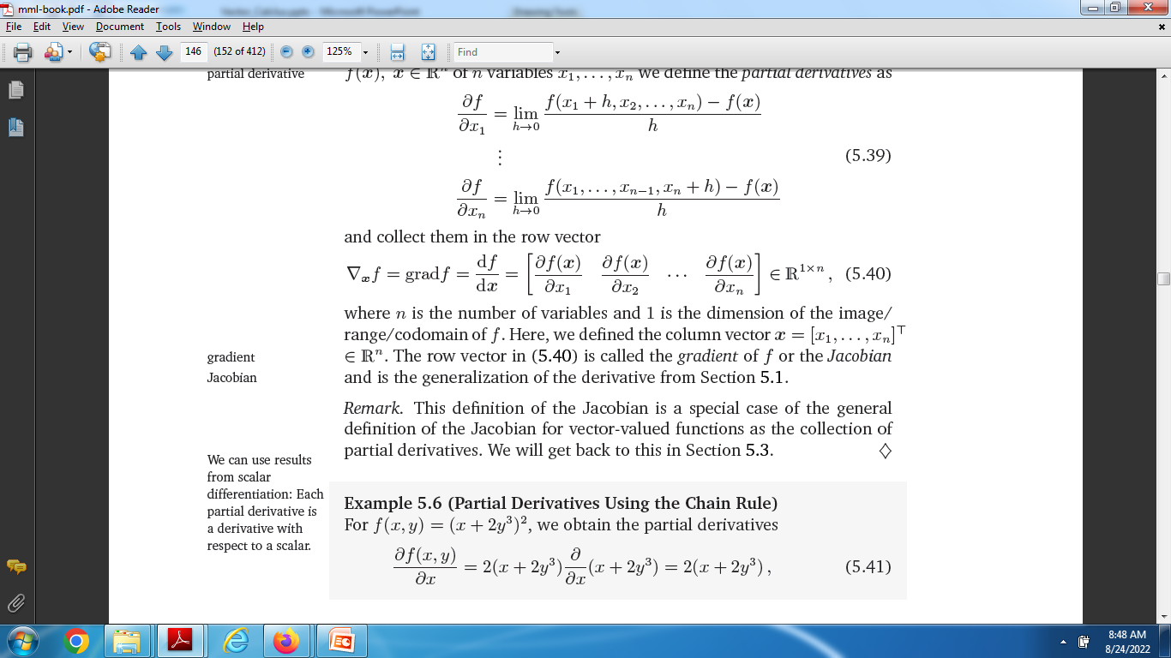
Partial Differentiation and Gradients

Slide 20
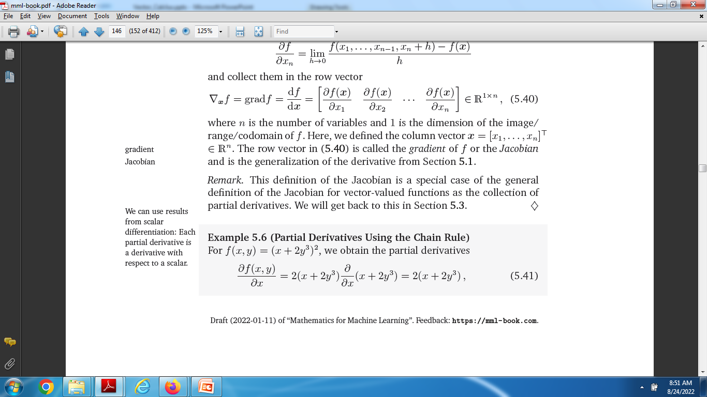
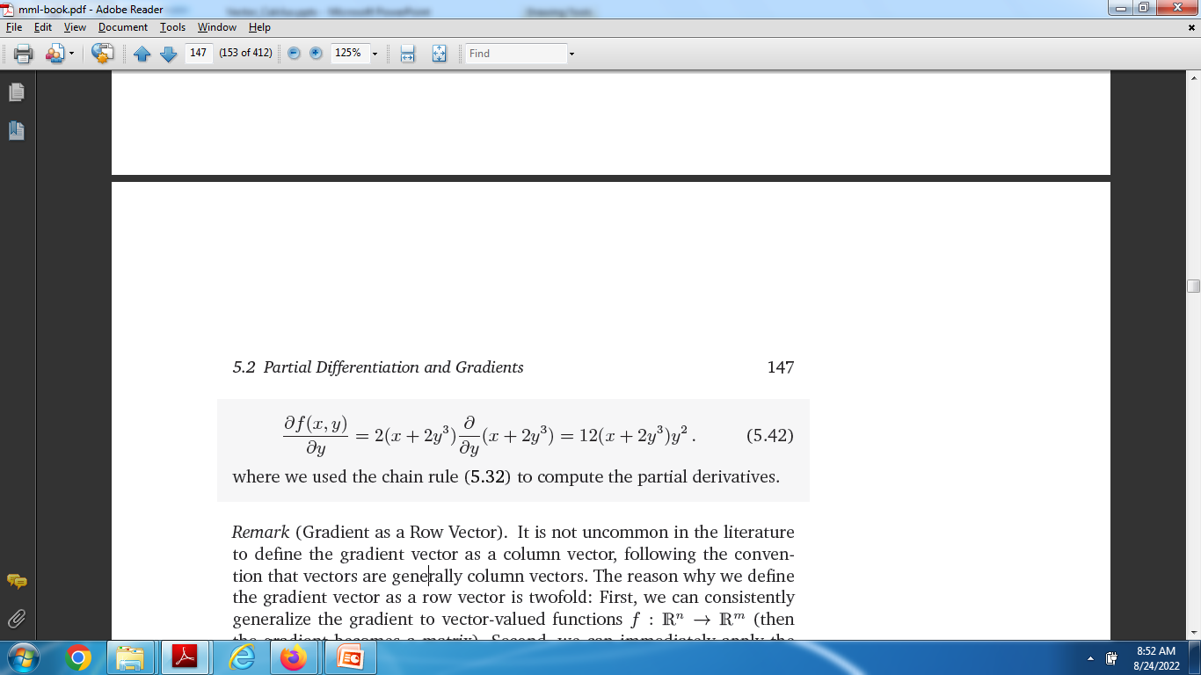
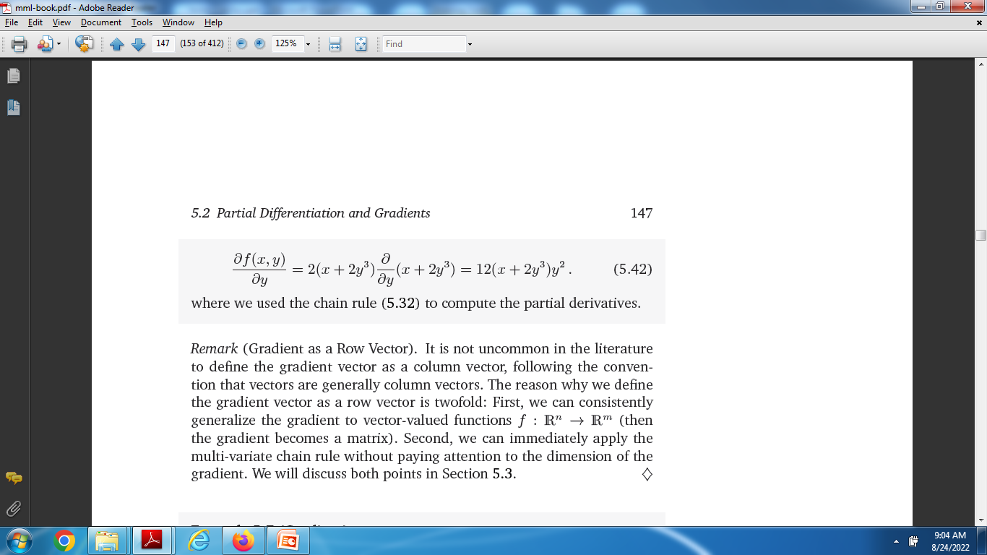
Partial Differentiation and Gradients

Slide 21
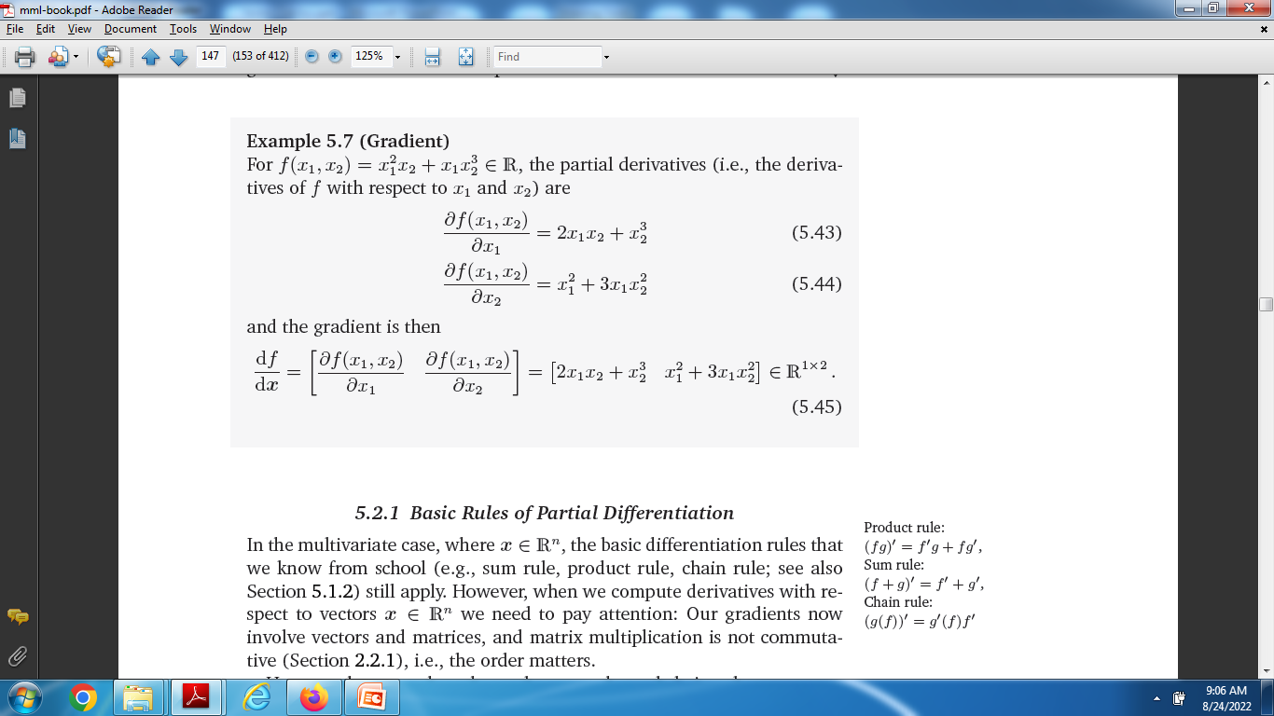
Gradient

Slide 22
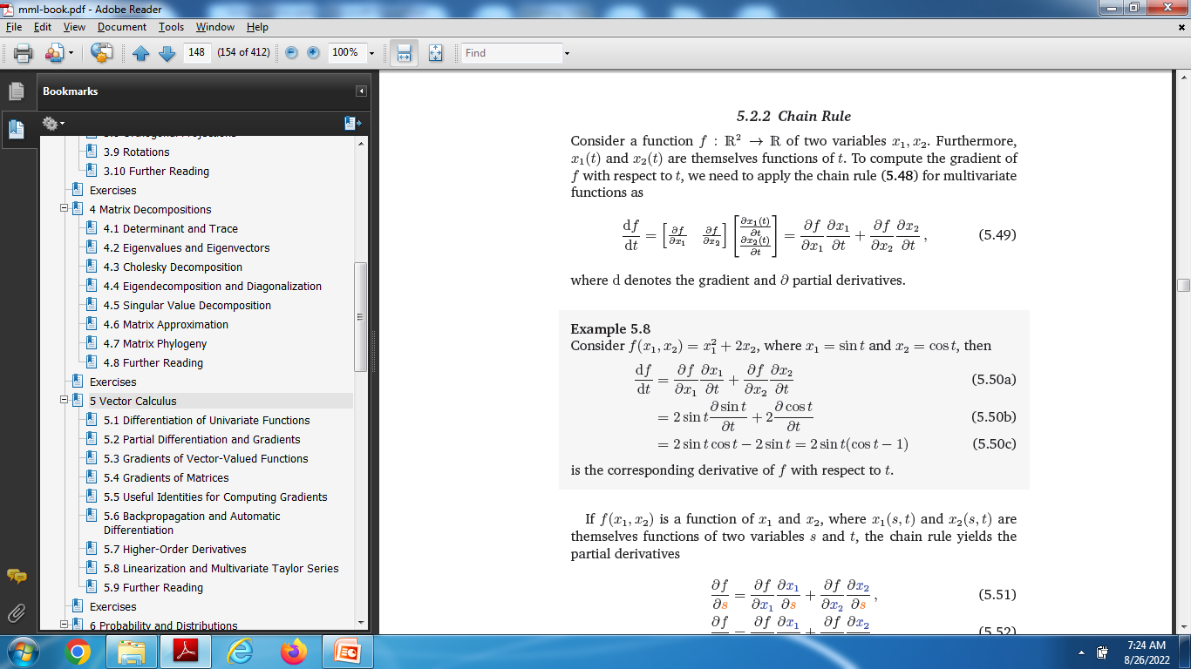
Chain Rules

Slide 23
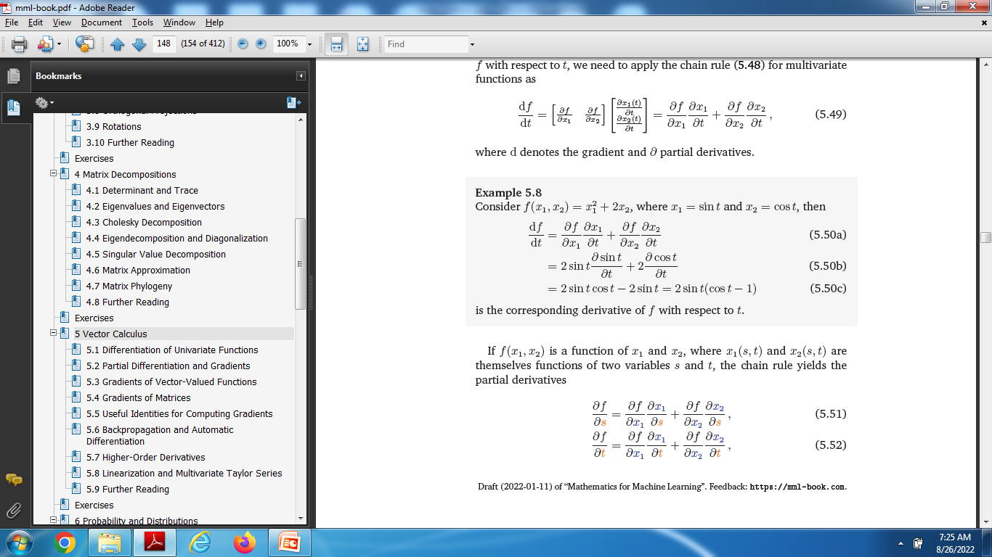
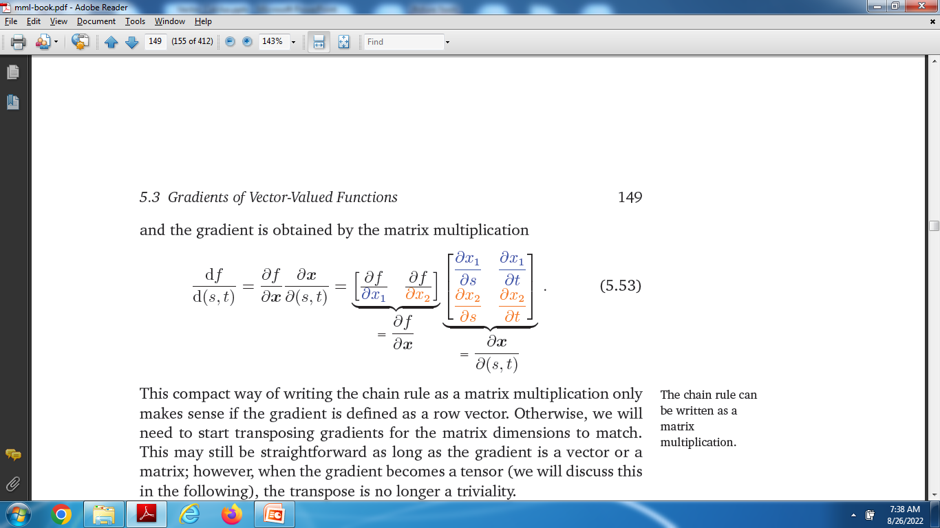

Slide 24
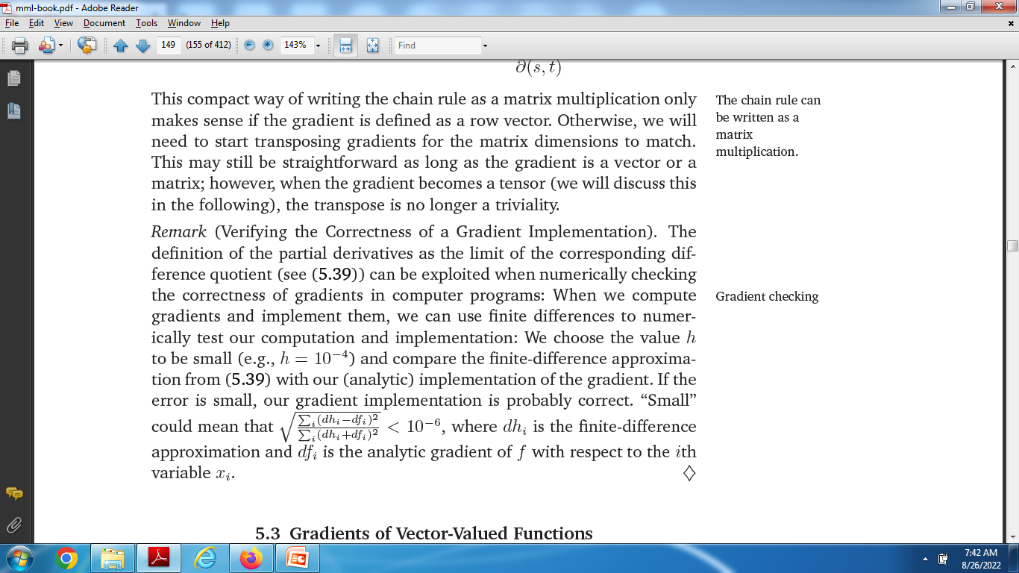

Slide 25
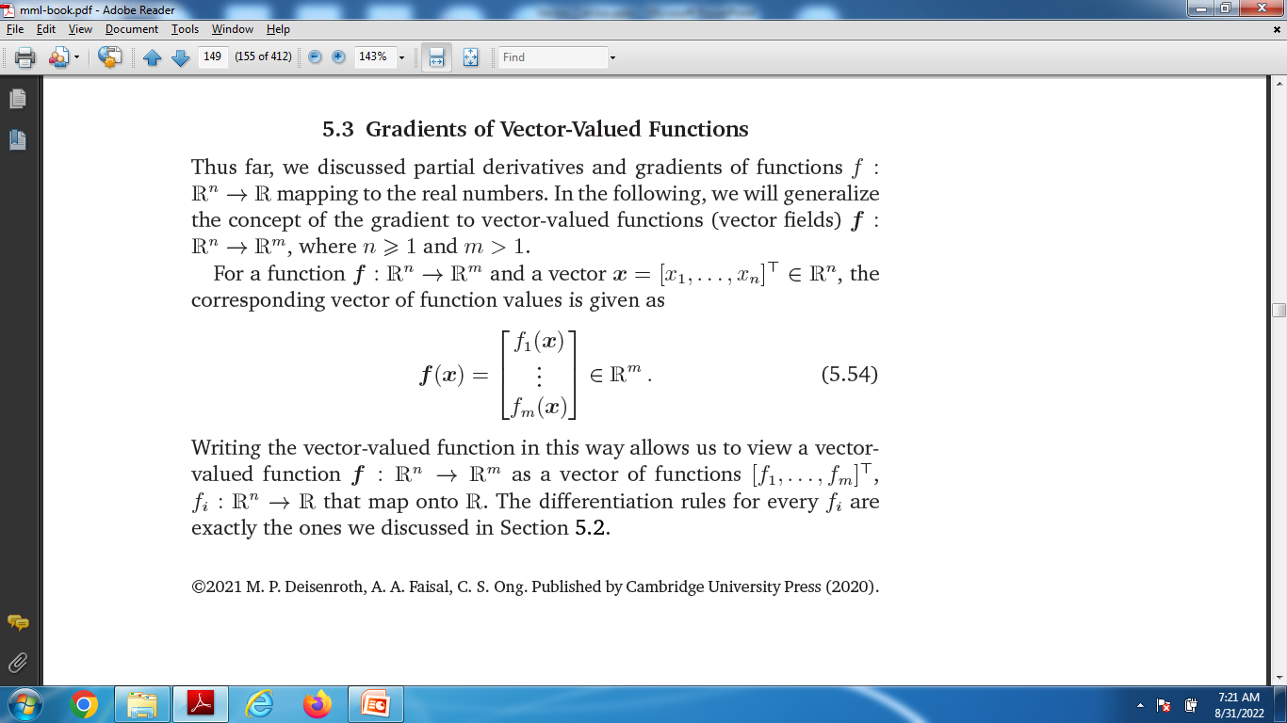
Gradients of Vector-Valued Functions

Slide 26
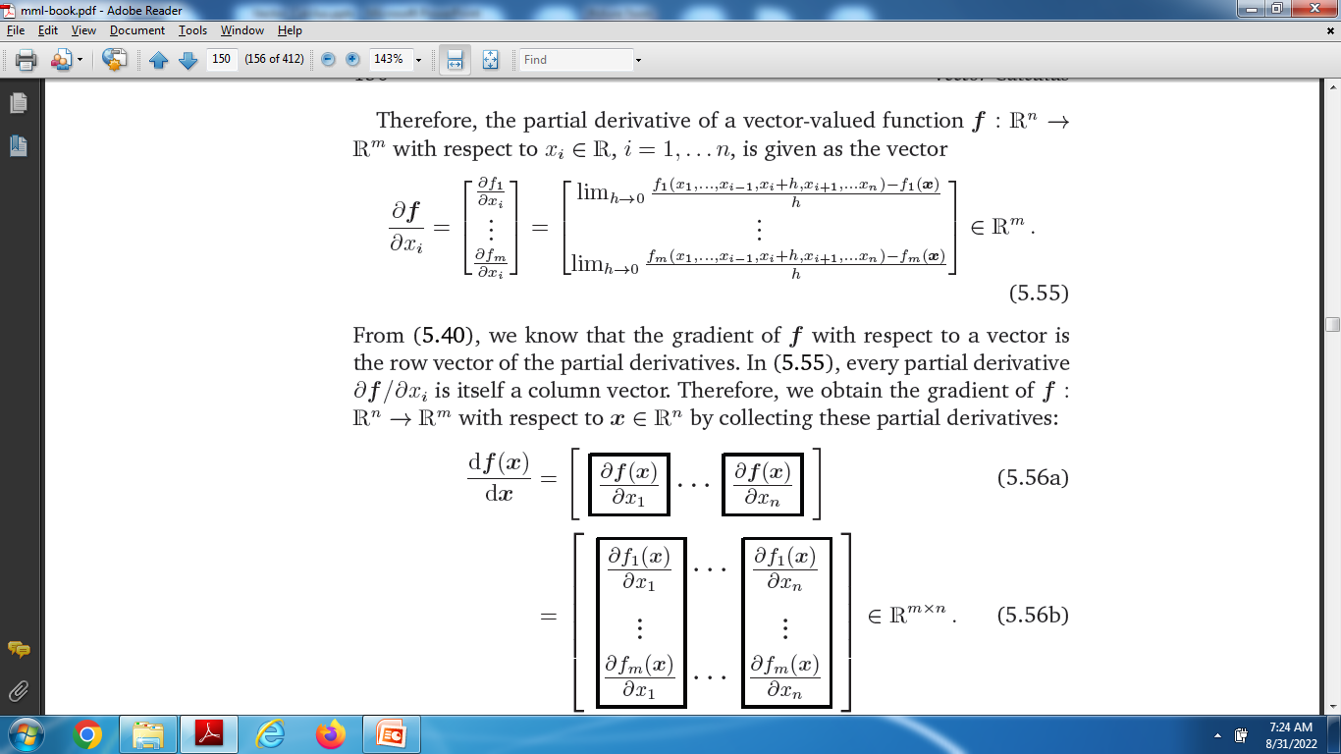
Gradients of Vector-Valued Functions

Slide 27
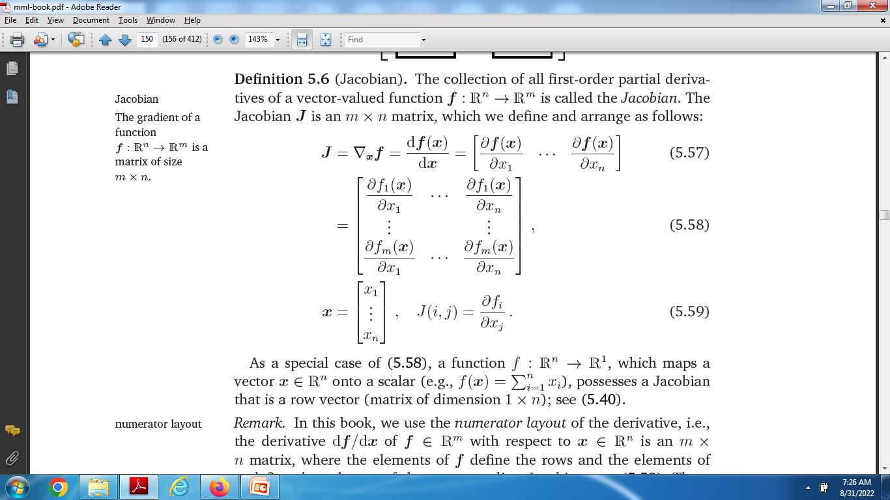
Jacobian

Slide 28
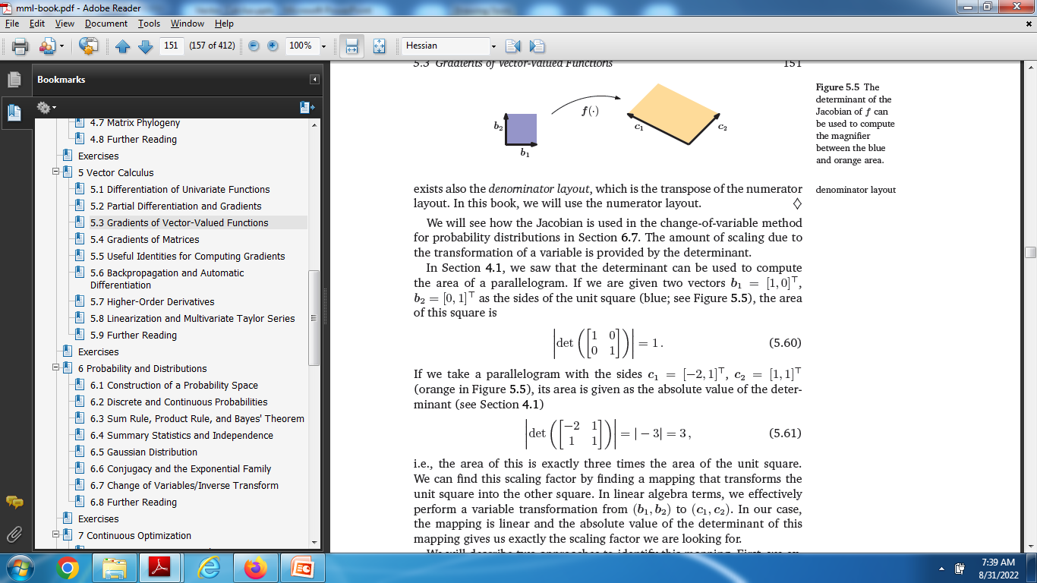
Jacobian is used to compute area of parallelogram

Slide 29
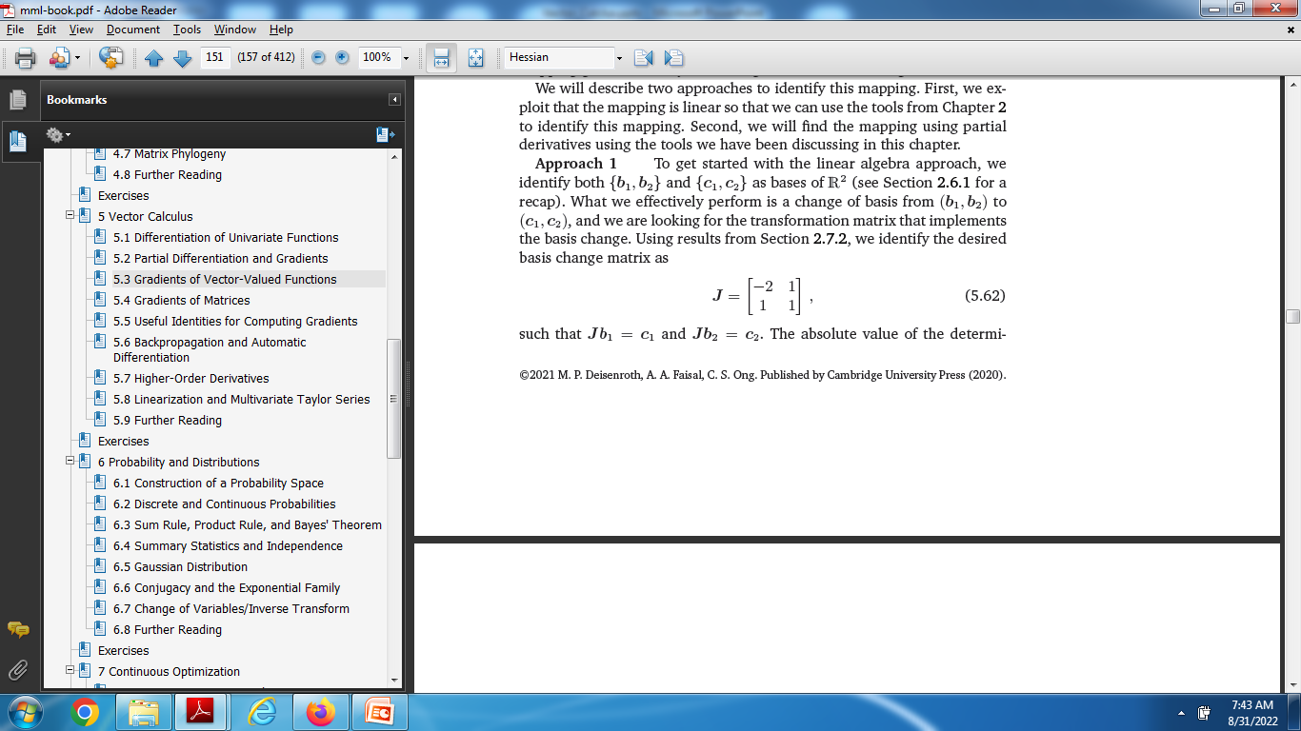
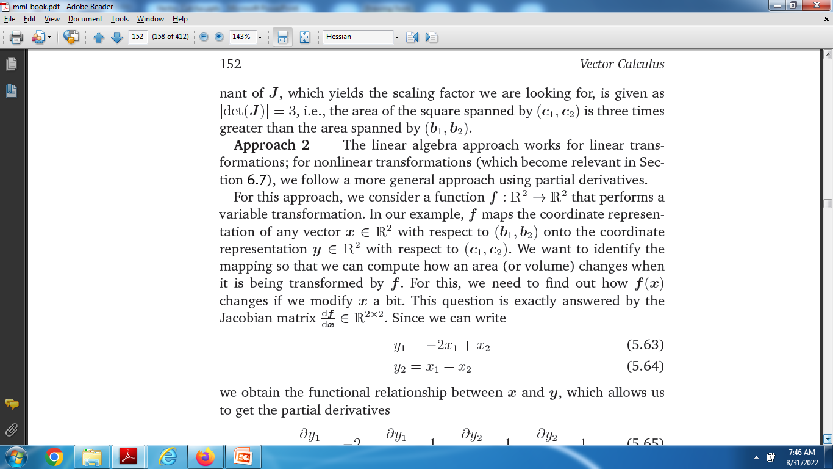

Slide 30
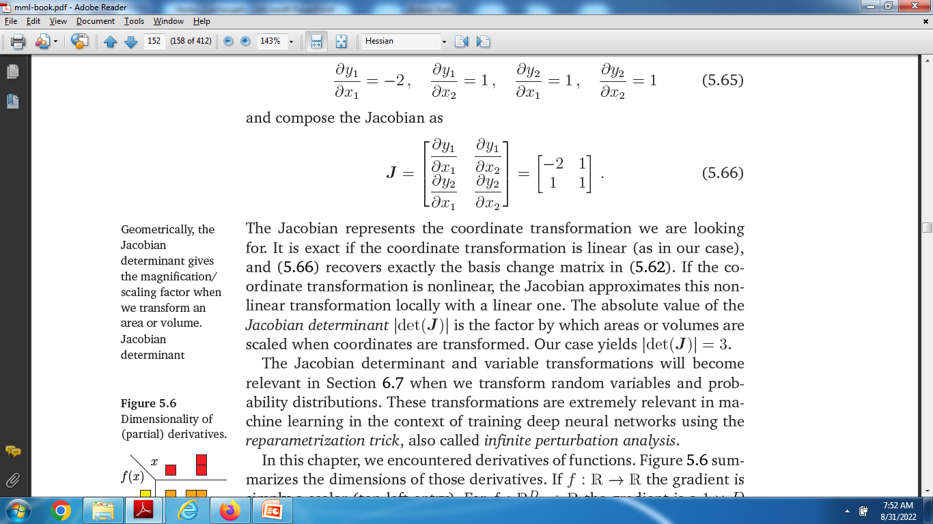

Slide 31
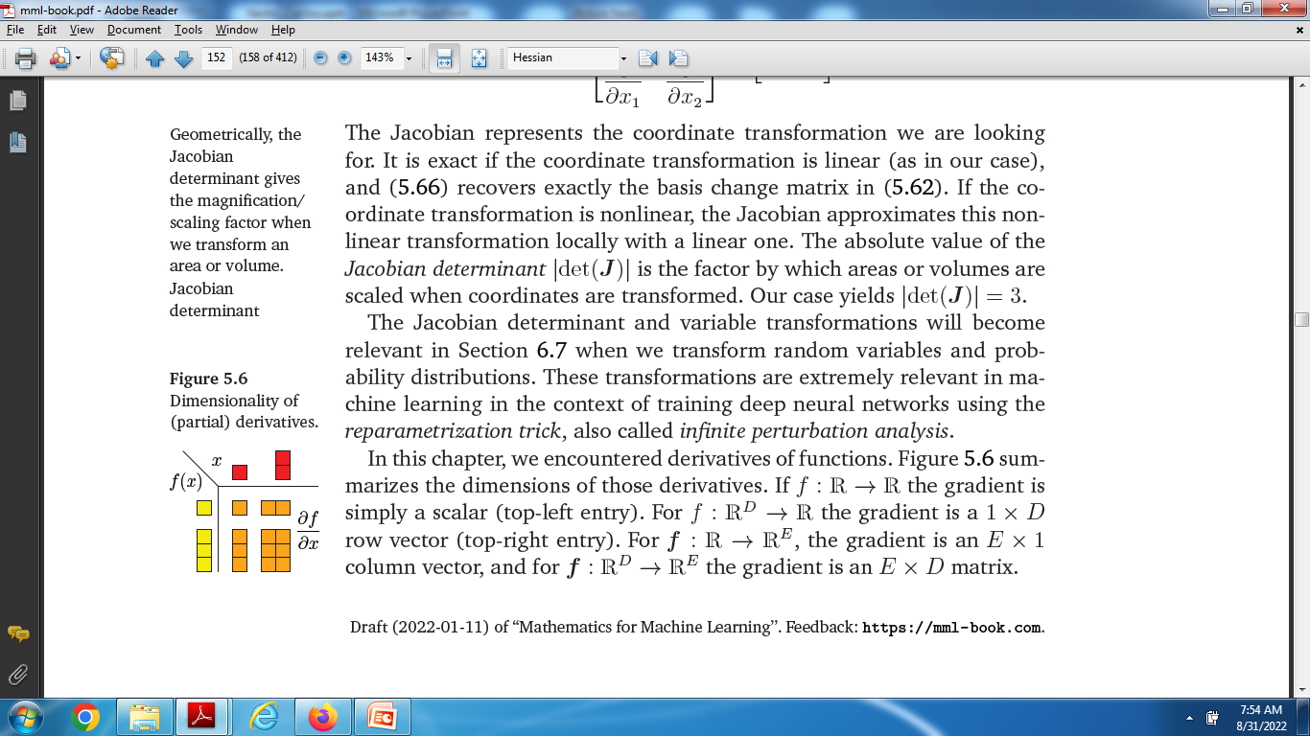

Slide 32
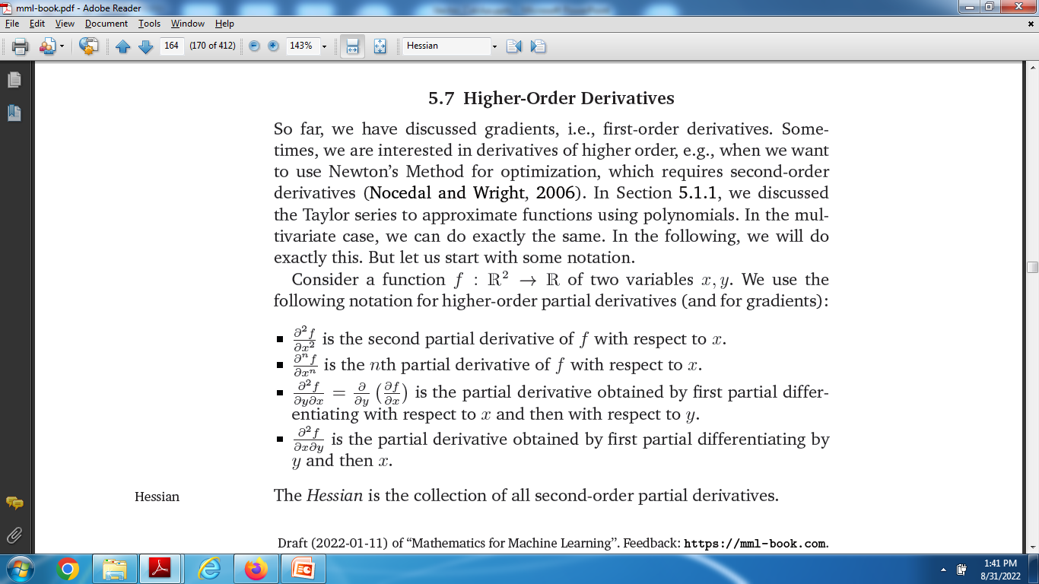
Higher-Order Derivative

Slide 33
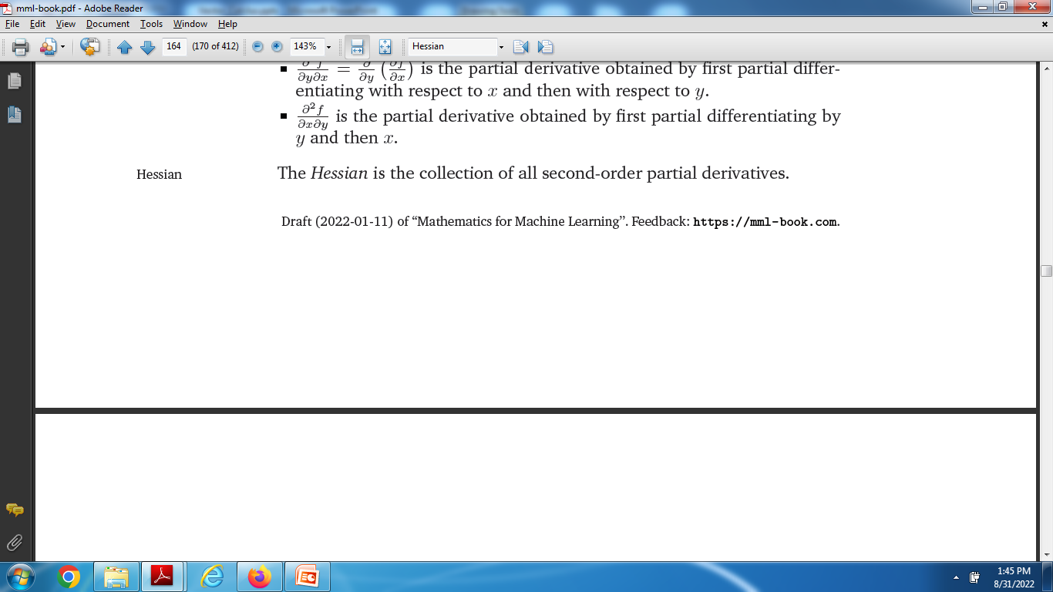
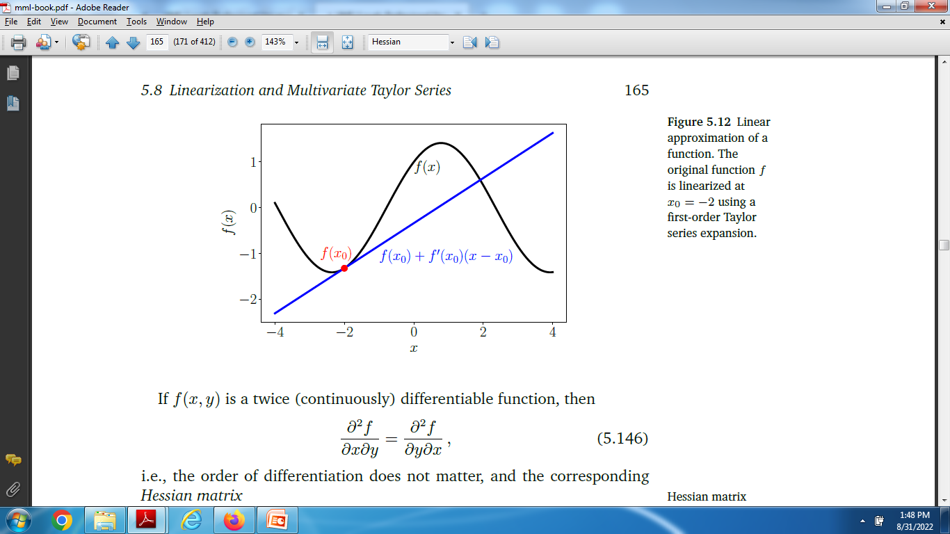
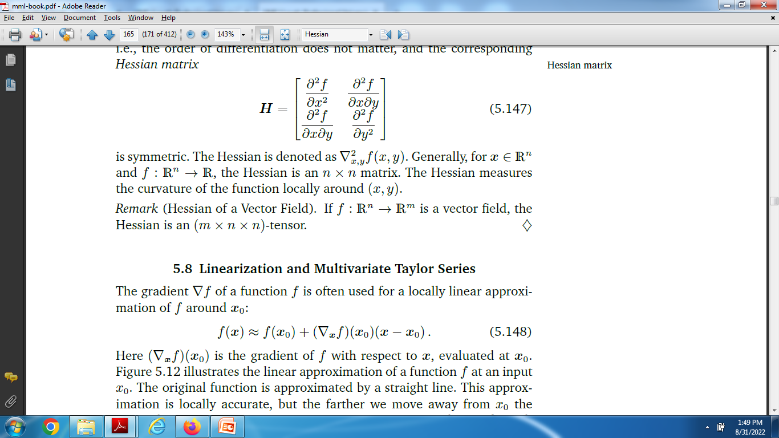
The Hessian

Slide 34
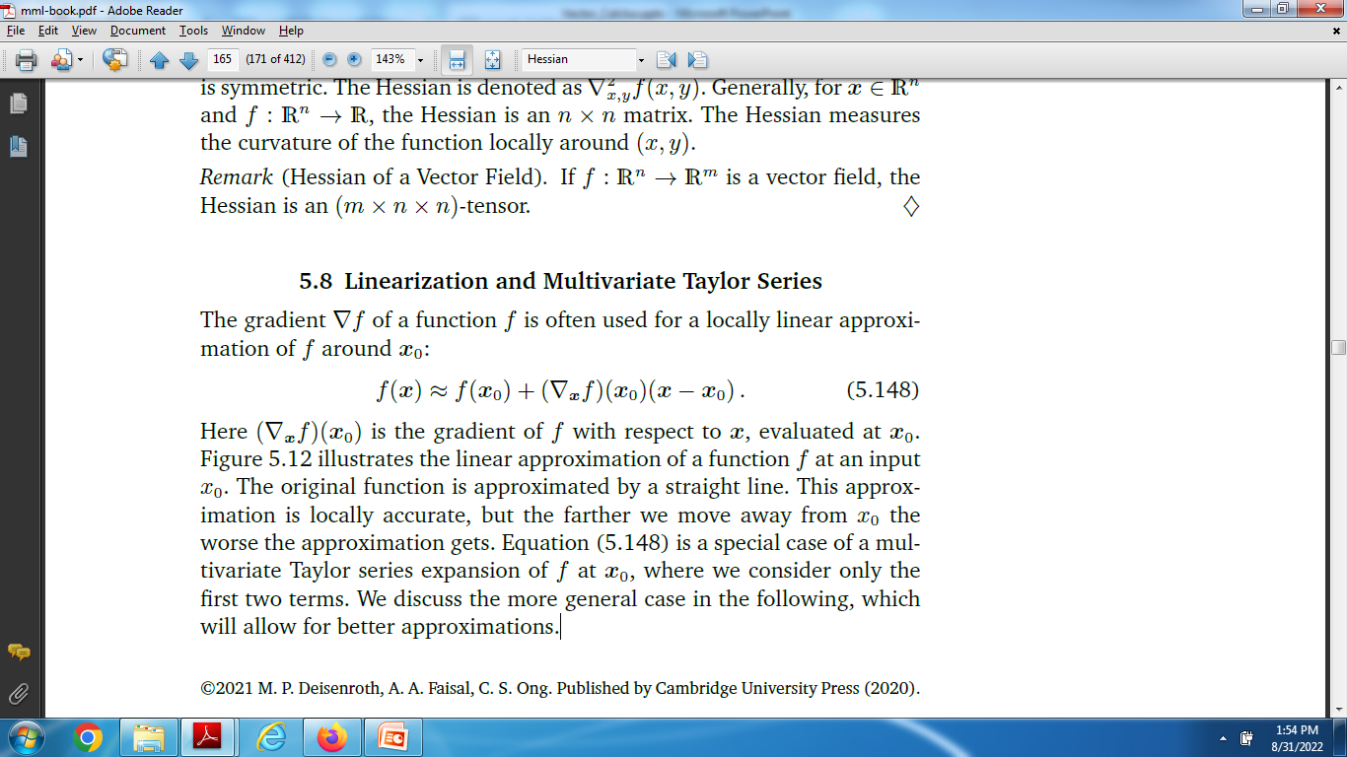
Linearization and Multivariate Taylor Series

Slide 35
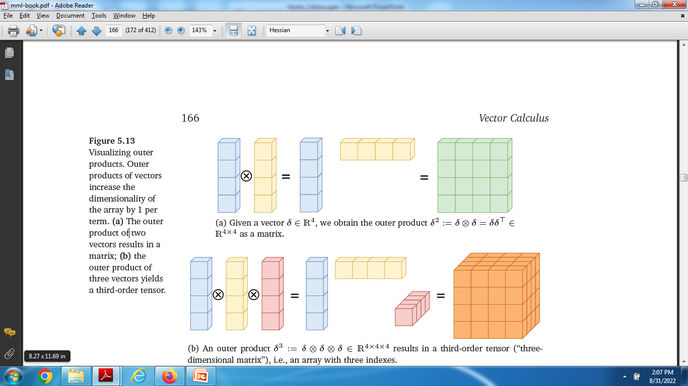

Slide 36
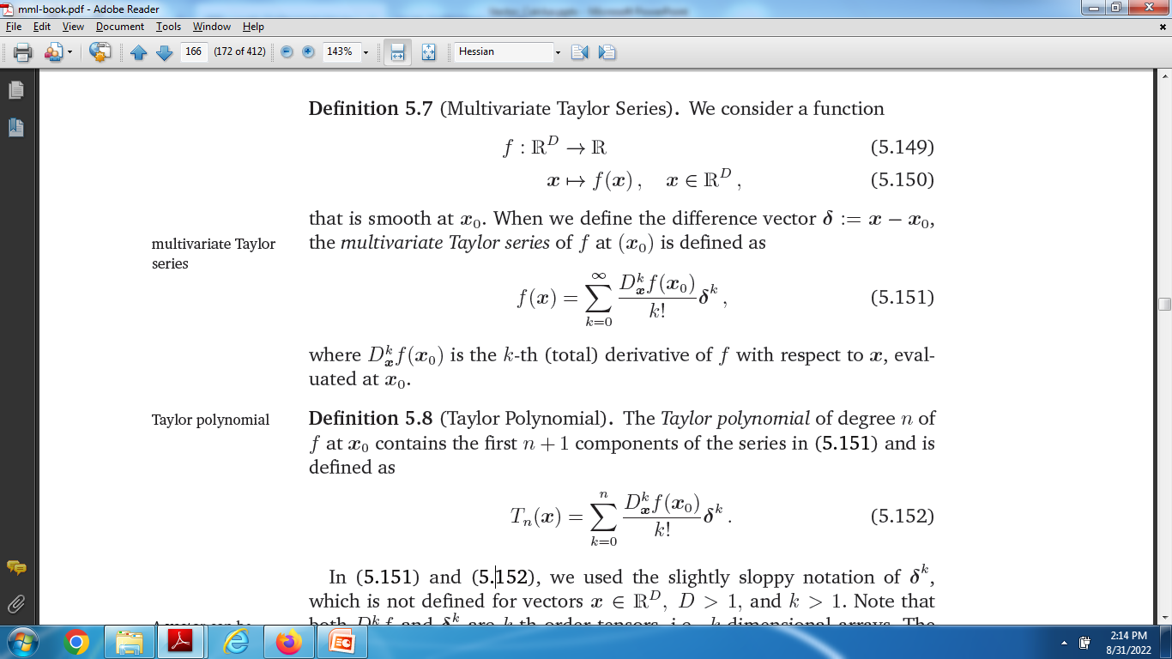
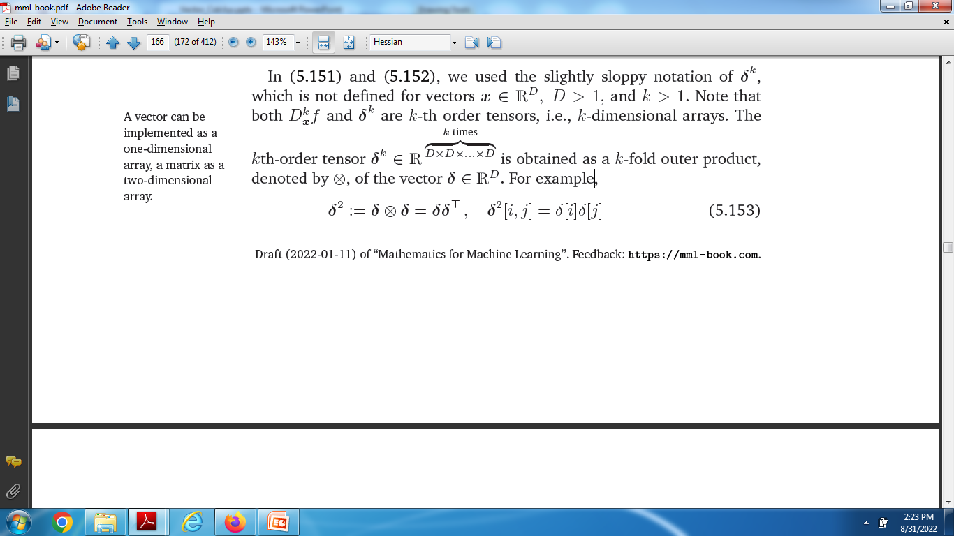

Slide 37
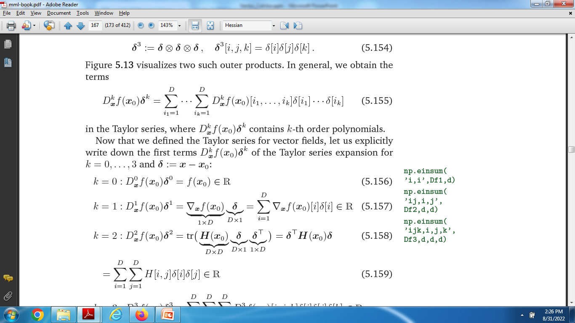
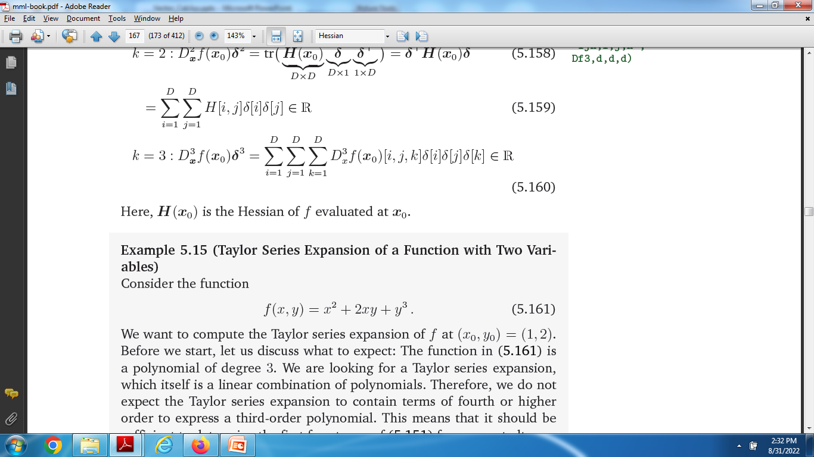

Slide 38
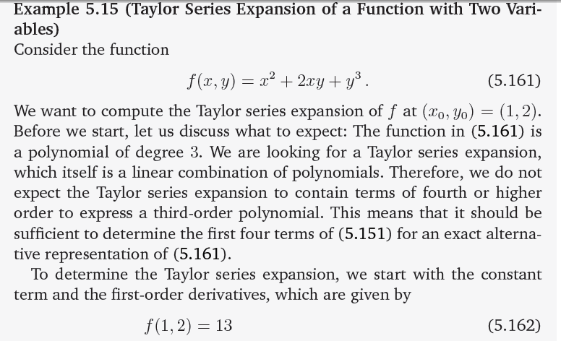
Example on Taylor Series

Slide 39
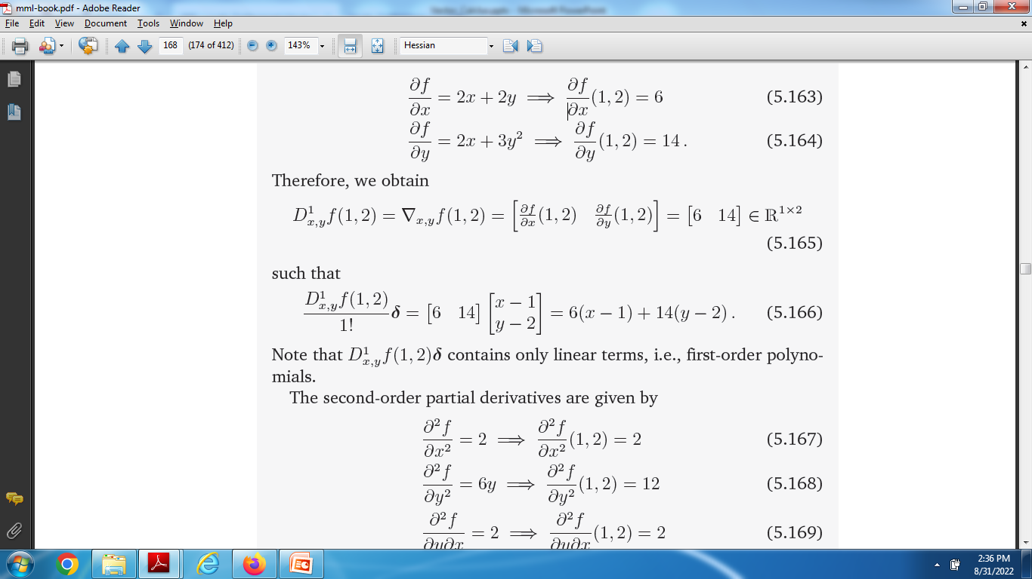

Slide 40
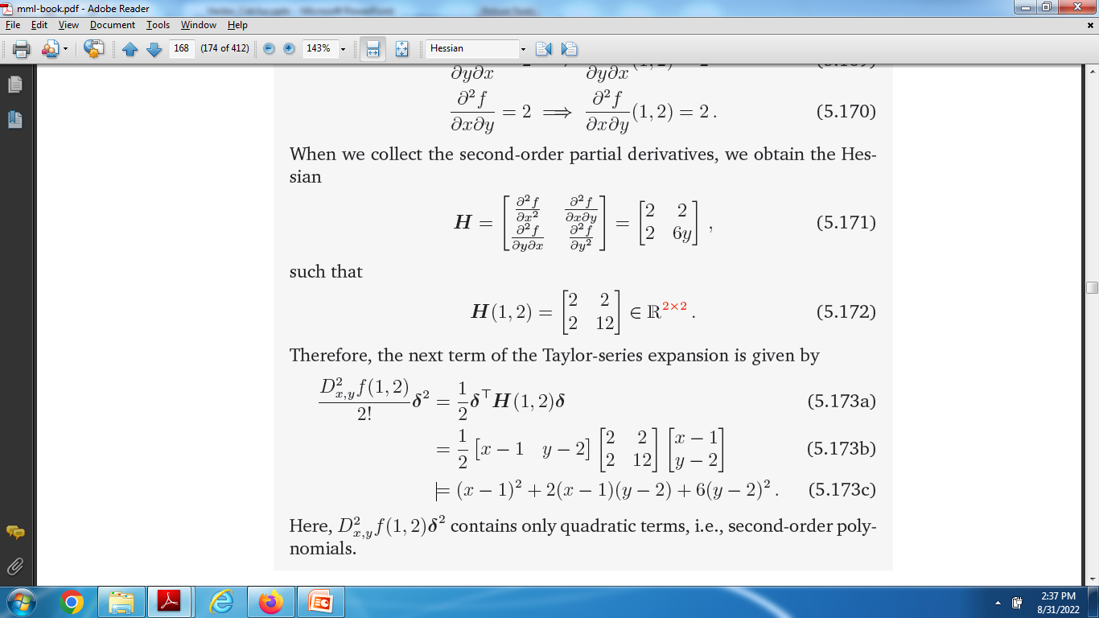

Slide 41



Slide 42


